Slide 1
ROLE OF PHYSIOTHERAPIST IN MUTIDISCIPLINARY CARE
VIKRANT BHARDWAJ (PT)
PhD Scholar, MPT (Ortho), PGC (Sports)
FOUNDER, PHYSIOREVIVE

Slide 2
CONTENTS
Introduction
Physiotherapy & its History
Branches of Physiotherapy
Multidisciplinary care
Role of Physiotherapist in Multidisciplinary Care
Advantages of Multidisciplinary Care

Slide 3
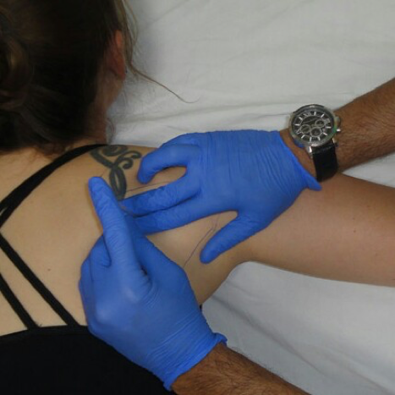
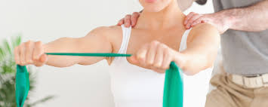
PHYSIOTHERAPY

Slide 4
DEFINITION OF PHYSIOTHERAPY
"Physiotherapists assess, plan and implement rehabilitative programs that improve or restore human motor functions, maximize movement ability, relieve pain syndromes, and treat or prevent physical challenges associated with injuries, diseases and other impairments.
They apply a broad range of physical therapies and techniques such as movement, ultrasound, heating, laser and other techniques. They may develop and implement programmes for screening and prevention of common physical ailments and disorders"

Slide 7
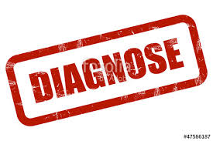
ROLE OF PHYSIOTHERAPY

Slide 9
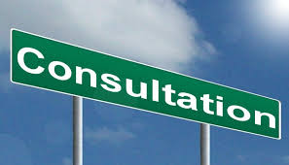
THE PHYSICAL THERAPY PROFESSION INCLUDE

Slide 10
PHYSIOTHERAPY

Slide 11
PHYSIOTHERAPY
HIPPOCRATES
GALEN

Slide 12
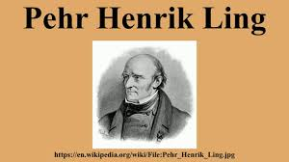
HISTORY

Slide 13
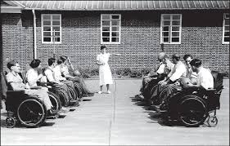
HISTORY

Slide 14
TRANSFORMATION OF PHYSIOTHERAPY

Slide 15
TRANSFORMATION OF PHYSIOTHERAPY

Slide 16
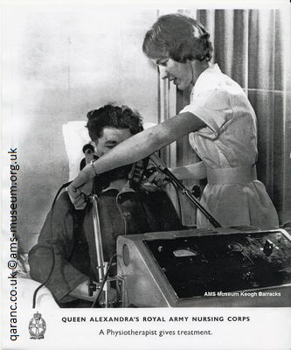
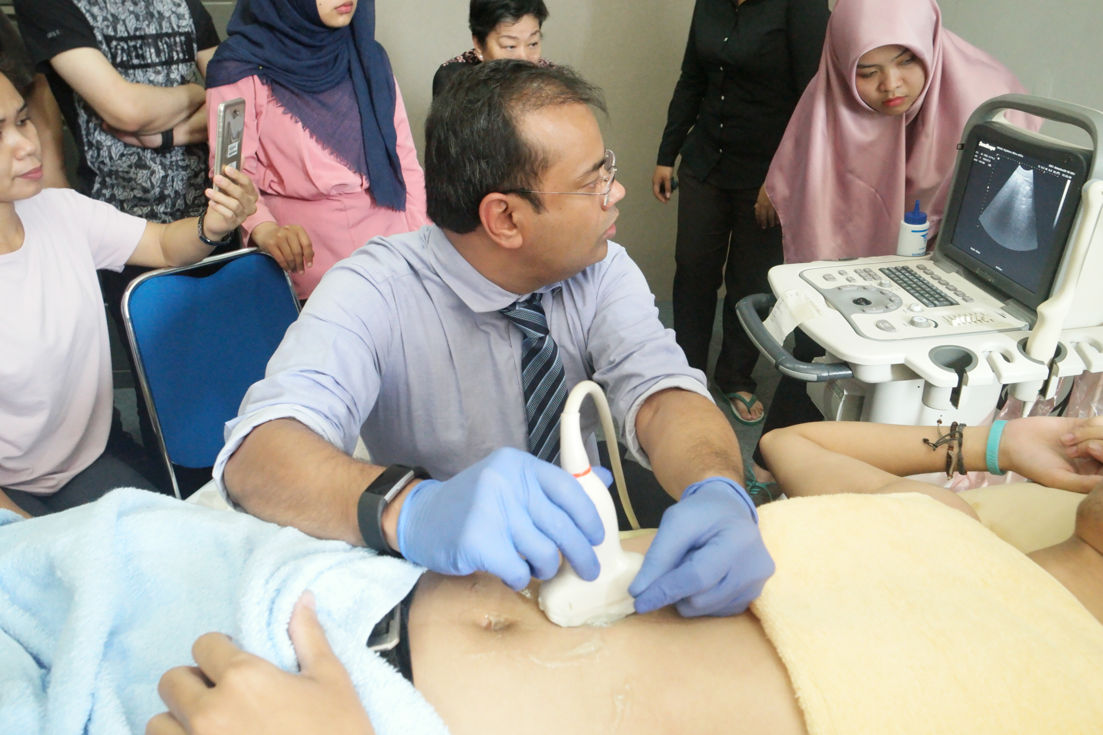
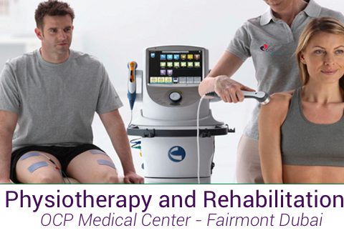
IN LAST 100 YEARS
SPECIALLY IN LAST 2 DECADES,…….THINGS HAVE REALLY CHANGED.

Slide 17
PHYSIOTHERAPY is a wide-ranging profession with opportunities to work in many different areas including
Respiratory physiotherapy on wards and intensive care units.
Neurological physiotherapy.
Musculoskeletal outpatients.
Orthopaedics.
Paediatrics.
Sports Physiotherapy with elite athletes.
Ergonomics.
Obstetrics & Gynae

Slide 18
MULTIDISCIPLINARY CARE
Multidisciplinary care occurs when professionals from a range of disciplines with different but complementary skills, knowledge and experience work together to deliver comprehensive healthcare aimed at providing the best possible outcome for the physical and psychosocial needs of a patient and their carers.

Slide 19
MULTIDISCIPLINARY CARE
Each professional has an UNIQUE importance & It’s a TEAM WORK!

Slide 20
MULTIDISCIPLINARY CARE

Slide 21
MULTIDISCIPLINARY CARE
Patient’s Video

Slide 22
ROLE AND RESPONSIBILITIES OF PHYSIOTHERAPIST IN MULTIDISCIPLINARY TEAM
Valuable members & contributing through :
promotion
prevention
screening
triage
assessment and treatment activities

Slide 23
ROLE AND RESPONSIBILITIES OF PHYSIOTHERAPIST IN MULTIDISCIPLINARY TEAM
Apart from the treatment of musculoskeletal conditions
physiotherapists have a well-established role to play in the treatment and maintenance of chronic conditions such as:
cardiovascular disease
COPD (chronic obstructive pulmonary disease)
Diabetes
Osteoporosis
Obesity
Hypertension

Slide 24
ROLE AND RESPONSIBILITIES OF PHYSIOTHERAPIST IN MULTIDISCIPLINARY TEAM
Broadly speaking, a physiotherapists roles, always rooted in restoring or developing healthy and functional mobility, involve
Evaluation
Using a Behavioural therapy approach help restore physical activities and improve the quality of life of patients
Evaluating patient's home environment and improving its accessibility and suitability for him/her and his/her condition

Slide 25
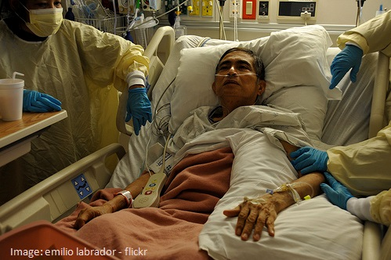
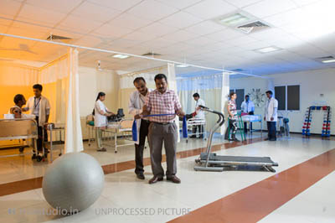
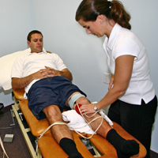
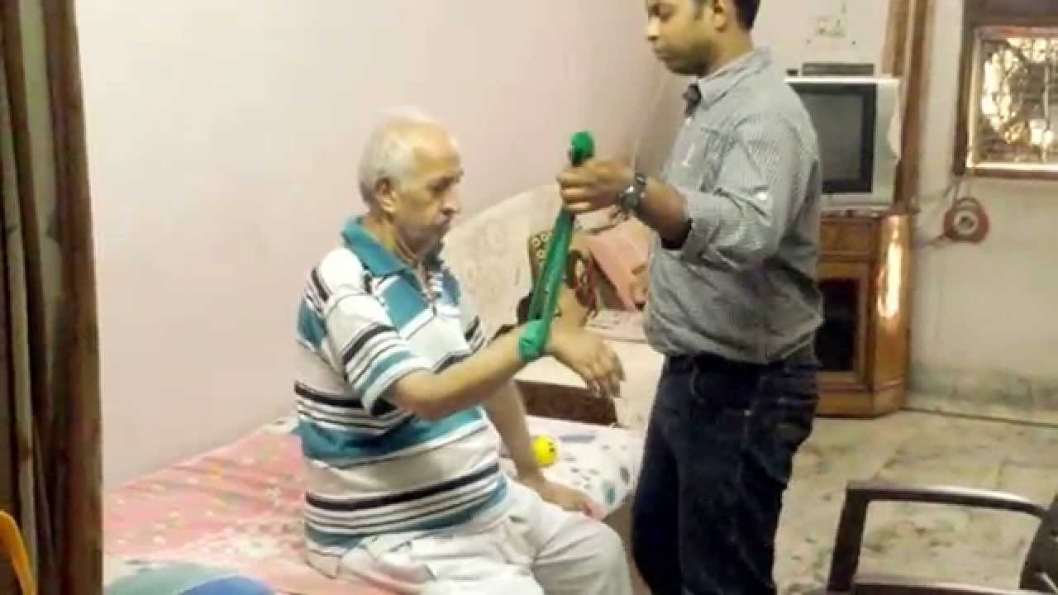
ROLE AND RESPONSIBILITIES OF PHYSIOTHERAPIST IN MULTIDISCIPLINARY TEAM

Slide 26
ADVANTAGES OF MULTIDISCIPLINARY CARE
Clinically Effective
Cost Efficient
Confidence
Compliance

Slide 27
ADVANTAGES OF MULTIDISCIPLINARY CARE
Allows a multidimensional diagnosis of condition
Avoids duplication of investigation
Facilitates early and accurate diagnosis (if waiting times are short)
Aids rapid initiation of treatment following diagnosis
Ensures the availability of a wide array of treatment options (pharmacological and nonpharmacological)
Treatment plans are individualised
Care is delivered in a programmed and coordinated manner
Provides continuity of interaction and care

Slide 28
ADVANTAGES OF MULTIDISCIPLINARY CARE
Treatment offered is up-to-date, evidence based and safe
Treatment failure can be recognised at the earlier stage
Faster return to work
Patients can have greater confidence in their treatment plan knowing that it has been developed by collaboration between different specialities
Patients have the opportunity to discuss treatment options and ask questions of the different specialists involved in their care
Improved interdisciplinary knowledge

Slide 29
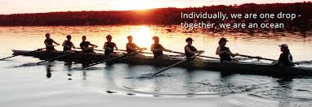
MULTIDISCIPLINARY CARE
It’s an approach to achieve good outcome & Physiotherapist has a definite role to play just like any other Health care Professionals in the team.

Slide 30
THANKS
Email: physiorevive@gmail.com
+91 9810 227 127

